Slide 1
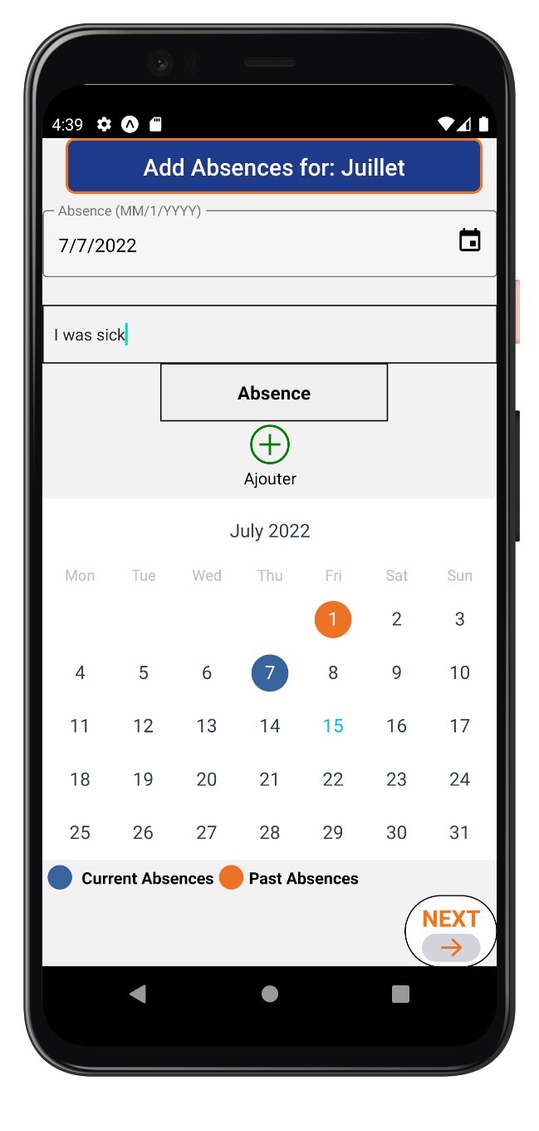
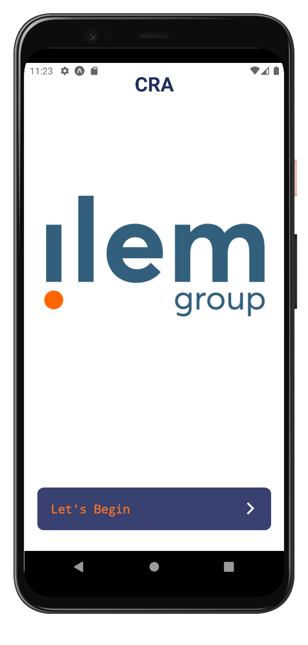


TIMESHEET MANAGEMENT MOBILE APPLICATION
Internship Presentation
Presented By: Mohammed Ait El Qadi
Supervised By: Dr. Kettani Driss
Mr. Marouane Bouzoubaa
Summer 2022

Slide 2
Table Of Contents
Internship Objectives
Internship Results
Screenshots of the application
01
02
03
04
05
06
07
INTRODUCTION
Internship Plan
Lessons Learned
Conclusion

Slide 3
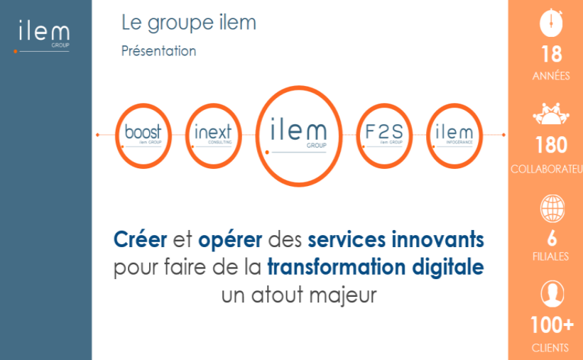
01
Introduction

Slide 4
02
Internship Objectives
WORK IN A PROFESSIONAL ENVIRONMENT ON REAL-LIFE PROJECTS
01
APPLY WHAT I HAVE LEARNED DURING MY STUDIES
02
IMPROVE MY SOFT AND HARD SKILLS
03

Slide 5
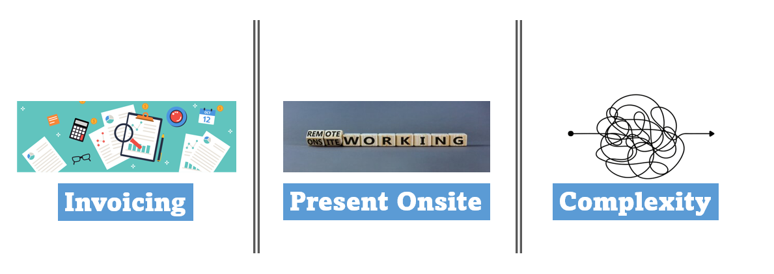
What Problem does the Application Solve ?

Slide 6
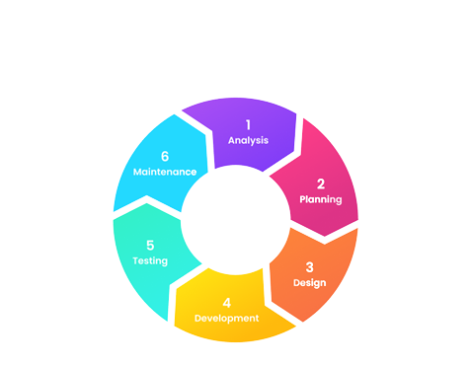
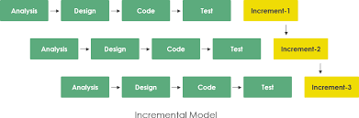
03
Internship Plan
Project Methodology
SE Process Model

Slide 7
04
Internship Results

Slide 8





Employee Functionalities
Month Selection
Monthly Absences
Monthly Activity
Submit Monthly Activity Report
Authenticate

Slide 9




Non-Functional Requirements
Performance
Security
Scalability
Usability

Slide 10







Technology Stack
Front-End
Back-End

Slide 11
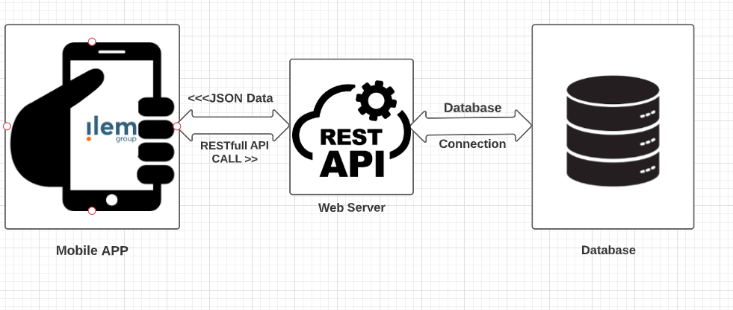
System Architecture

Slide 12
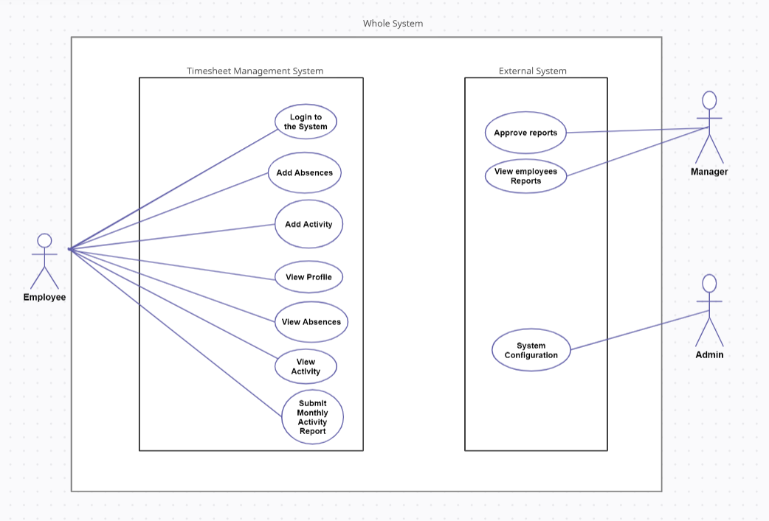
Use-Case Diagram

Slide 13
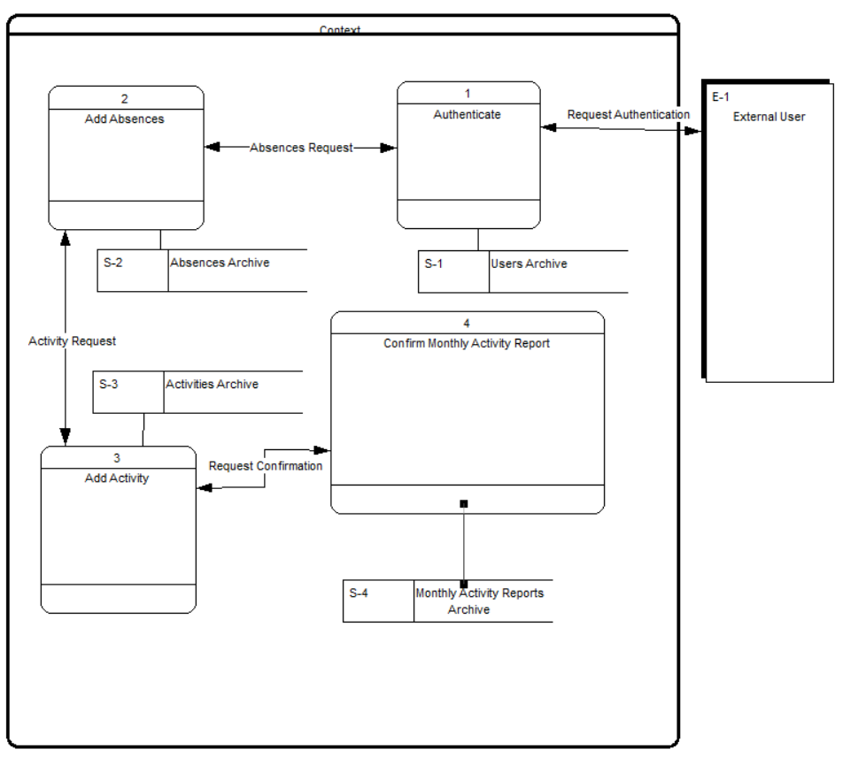
Conceptual Process Model

Slide 14
05
Lessons Learned
Soft Skills
Hard Skills
Strong Communication
Time-Management
Critical Thinking
Adaptability
Self-Learning
Decision making
REST architecture
Web Services
JWT
New JS frameworks
Security Aspects

Slide 15
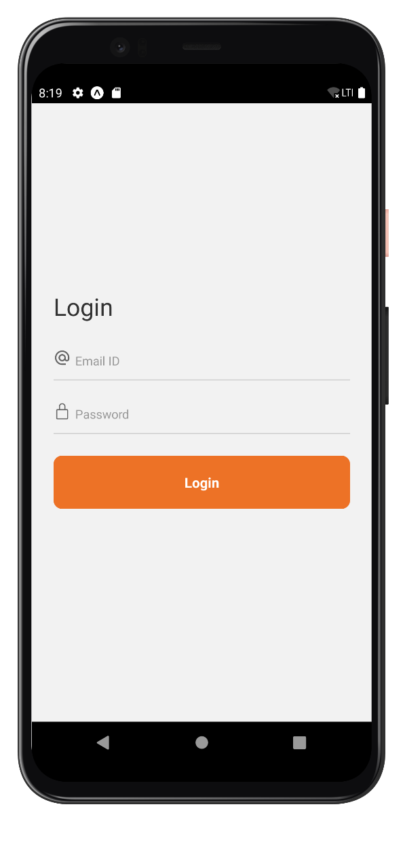
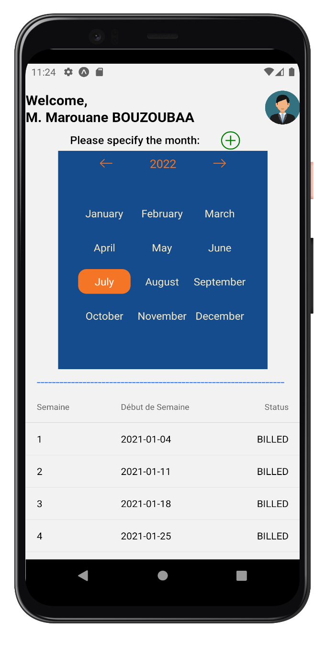
06
Screenshots of the application

Slide 16
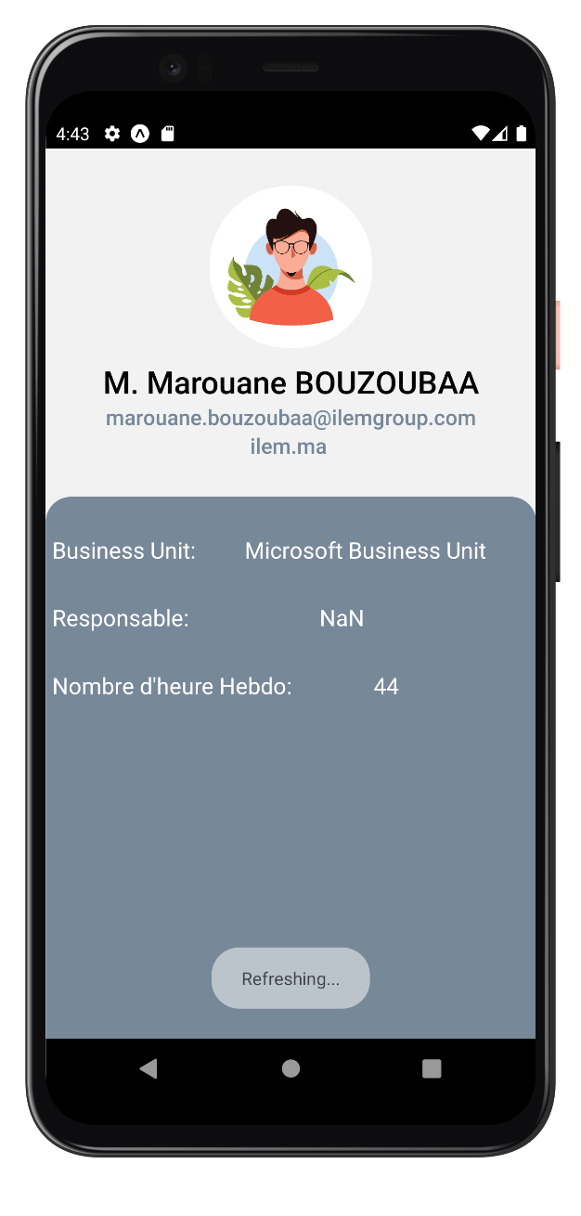
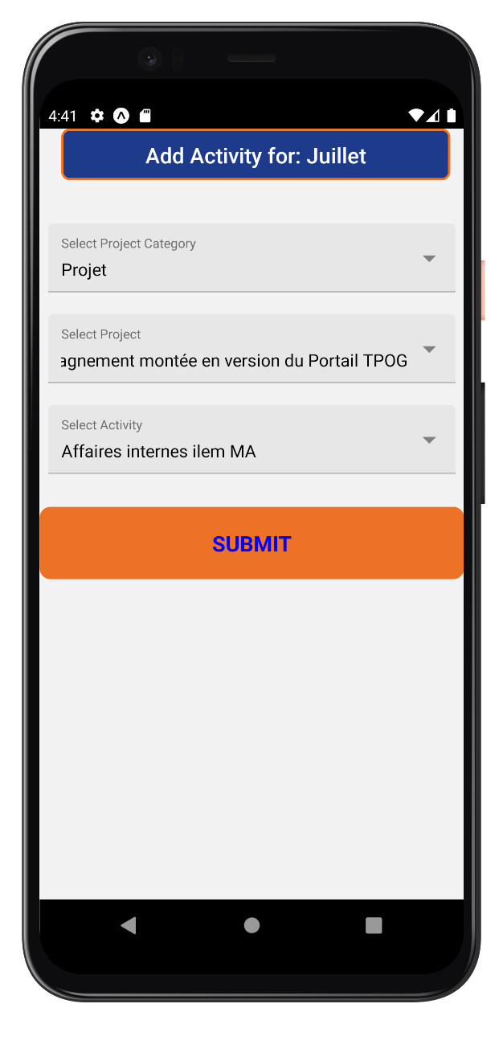
06
Screenshots of the application (Cont.)

Slide 17
07
Conclusion
This internship experience was a great opportunity for me to apply all the concepts that I learned during my undergraduate studies to create a solution that is going to be used in a professional workplace. Other than that, I realized that the soft skills that we acquired at university are very important to success in the professional world
Challenges:
Debugging
Time Management
Lack of technical skills

Slide 18

THANK YOU !
ANY QUESTIONS?

